Slide 1
COMPUTER PROGRAMMING
MODULE-1
Decision Making-Branching and looping
Notes:
Module-2(Branching and Looping)

Slide 2
BRANCHING AND LOOPING
Decision Making and Branching:
Simple –if
if-else
if-else-if-else(else-if ladder)
Switch case and
Nested-if
Conditional Operator.
Looping:
While
For
do-while
Nested Looping Statements.
Notes:
Module-2(Branching and Looping)

Slide 3
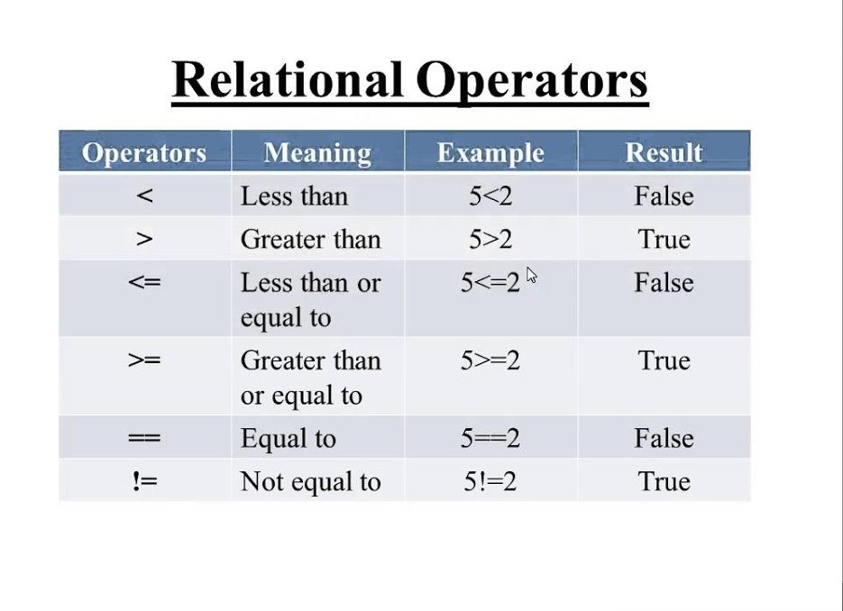
RELATIONAL OPERATORS
Notes:
Module-2(Branching and Looping)

Slide 4
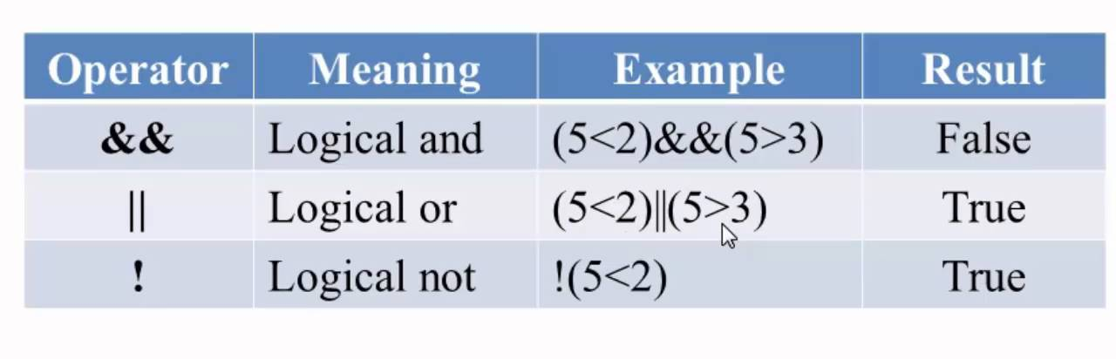
LOGICAL OPERATORS
Notes:
Module-2(Branching and Looping)

Slide 5
The SIMPLE if Statement
The simple if statement has the following syntax:
if (expression)
{
statement-block;
}
statement x;
If the test expression is true, the statement-block is executed; if it is false, the statement is skipped and Execution will jump to statement x.
This provides basic decision making capabilities
Notes:
Module-2(Branching and Looping)

Slide 6
Example
if( age>=18)
{
printf(“ Eligible to vote”);
}

Slide 7
The if-else Statement
The if-else statement has the following syntax:
if (expression)
{
True-statement-block;
}
else
{
False-statement-block;
}
Statement x;
If the test expression is true, then True statement-block is executed; if it is false, then False statement block is executed. In both the cases control is transferred subsequently to Statement x
This provides basic decision making capabilities

Slide 8
Example
if ( age>=18)
{
printf(“Eligible to vote”);
}
else
{
printf(“Not eligible to vote”);
}

Slide 9
ELSE-IF LADDER
The execution of else-if ladder statement is as follows
The conditions are evaluated from the top as soon as a true condition is found , the statement associated with it is executed and the control is transferred to the statement-x;
When all the n conditions become false , then the final else containing the default-statement will be executed.

Slide 10
EXAMPLE
if (code==1)
printf(“colour=“red”);
else if( code ==2)
printf(“colour=“yellow”);
else if(code==3)
printf(“colour=“green”);
else
printf(“invalid input”);
;

Slide 11
Switch case
Syntax:
switch (expression)
{
case value-1:
statement-1;
break;
case value-2:
statement-2;
break;
-----------
default:
statement-n;
break;
}
Statement-x;

Slide 12
SWITCH CASE
The execution of Switch case statement is as follows
The value of the expression is successfully compared against the values value1,value2…
If a case is found whose value matches with in the value of the expression , then the block of statements that follows the case are executed.
The break statement at the end of each block signals the end of a particular case and causes an exit from the switch statement and transferring the control to the statement-x following switch.
The default is an optional case when present it will be executed if the value of the expression does not match with any of the case values.
If not present ,no action takes place if all matches fail and the control goes to the statement-x;

Slide 13
EXAMPLE
switch(character)
{
case ‘A’ : printf(“Green”);
break;
case ‘B’: printf(“Yellow”);
break;
case ‘C’: printf(“Red”);
break;
default : printf(“ no choice”);
}

Slide 14
LOOPING
While
Do-While
For

Slide 15
FOR STATEMENT
Syntax:
for ( initialization; test condition ; increment)
{
body of the loop
}
The execution of for statement is as follows
The initialization of the control variables is done first.
The test condition is a relational expression. If it is true the body of the loop is executed otherwise execution continues with the statement that immediately follows the loop
The control variable is incremented using an assignment statement .This process continues till the value of the control variable fails to satisfy the test condition.

Slide 16
EXAMPLE
for( i=1 ; i < n ; i++)
{
printf(“%d”, i);
}
printf(“\n”);

Slide 17
THE WHILE STATEMENT
Syntax
while ( test condition )
{
body of the loop
}
The test condition is evaluated and if the condition is true then body of the loop is executed.
Example
while(n<=10)
{
sum=sum+n;
}

Slide 18
THE DO STATEMENT
Syntax:
do
{
body of the loop
}
while(test condition);
The execution of Do-While statement is as follows
Do statement evaluates the body of the loop first.
At the end of the loop test-condition in the while statement is evaluated.
If the condition is true the program continues to evaluate the body of the loop once again.
This process continues as long as the test condition is true.
When the test condition becomes false , the loop will be terminated and the control goes to the statement that appears immediately after the while statement.

Slide 19
EXAMPLE
do
{
sum=sum+i;
i=i+2;
}
while(sum<40);

